Slide 1
IAR User Guide

Slide 2
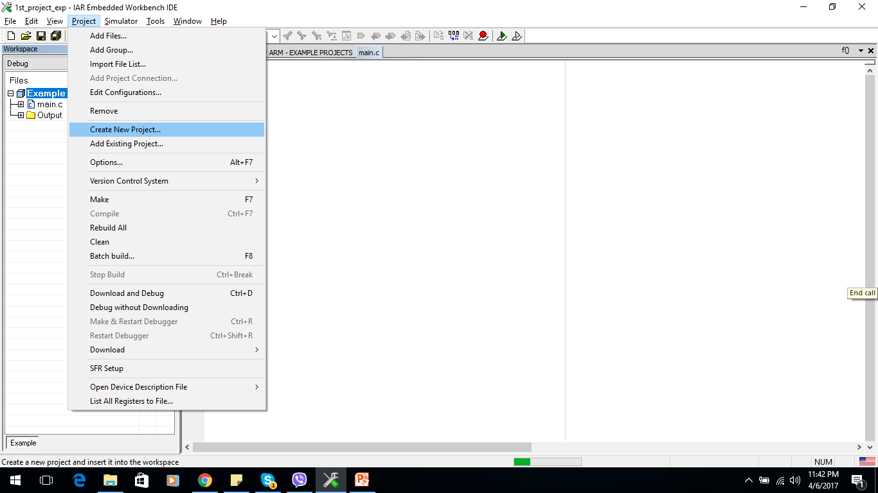
1. Create new project
Step 1: Create new project

Slide 3
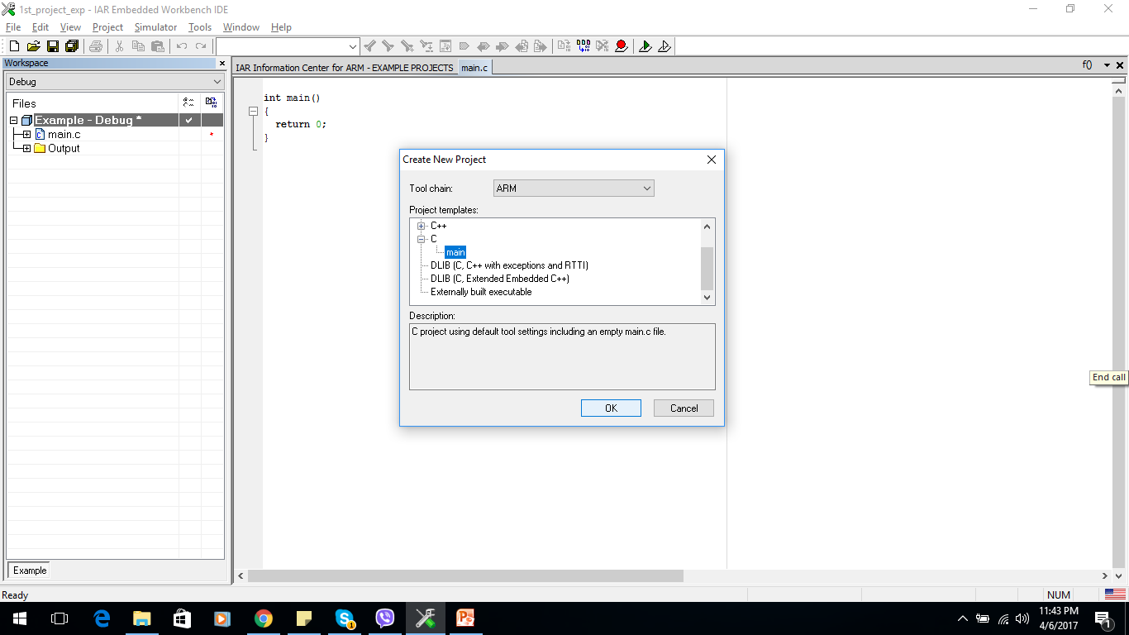
1. Create new project
Step 2: Choose file main used by C

Slide 4
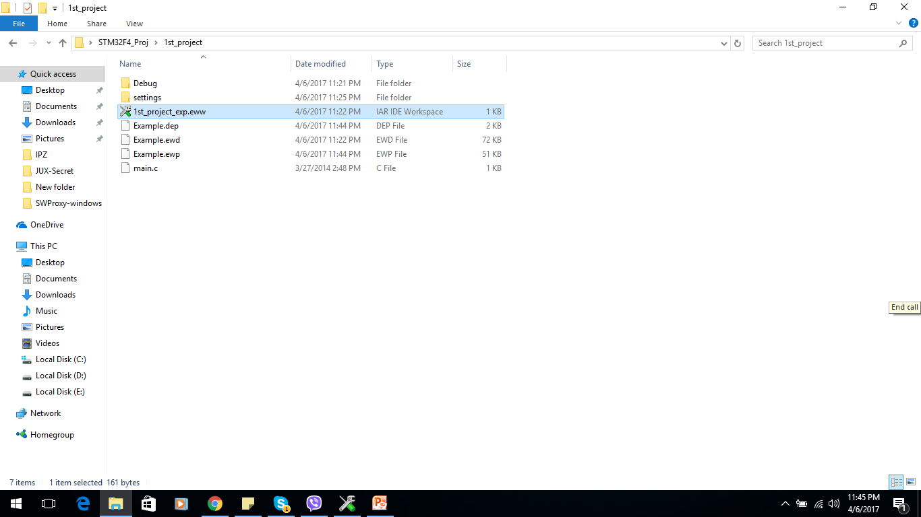
1. Create new project
Step 3: Choose path folder name
-> Click save all for work pace

Slide 5
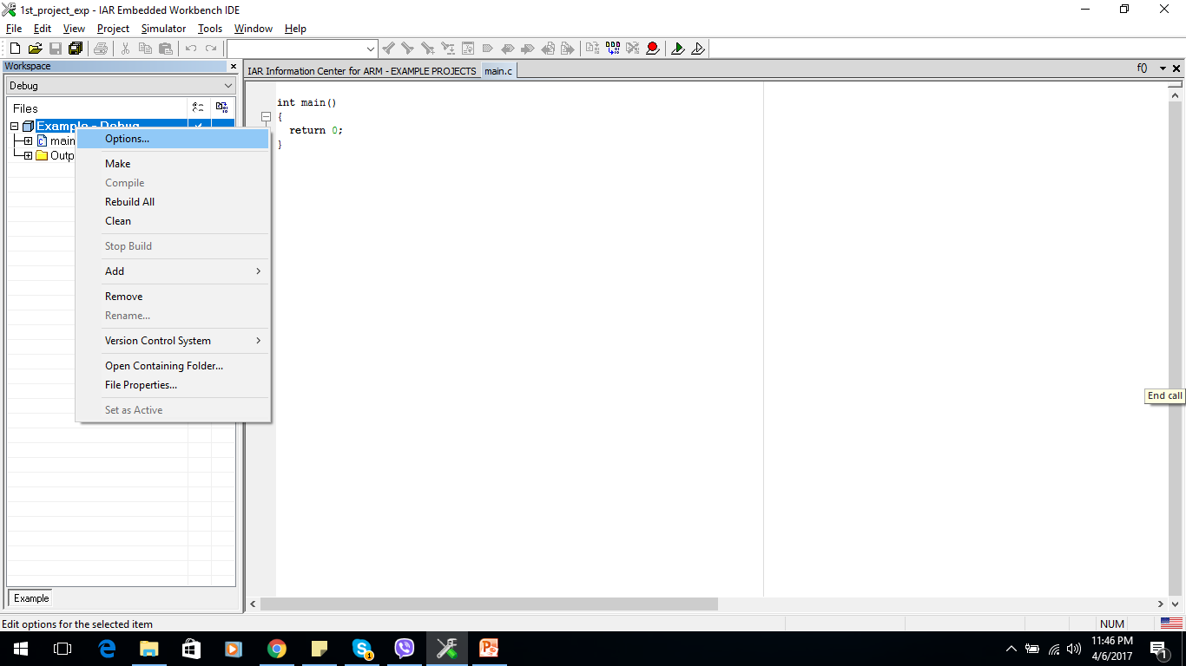
1. Create new project
Step 4: Configuration

Slide 6
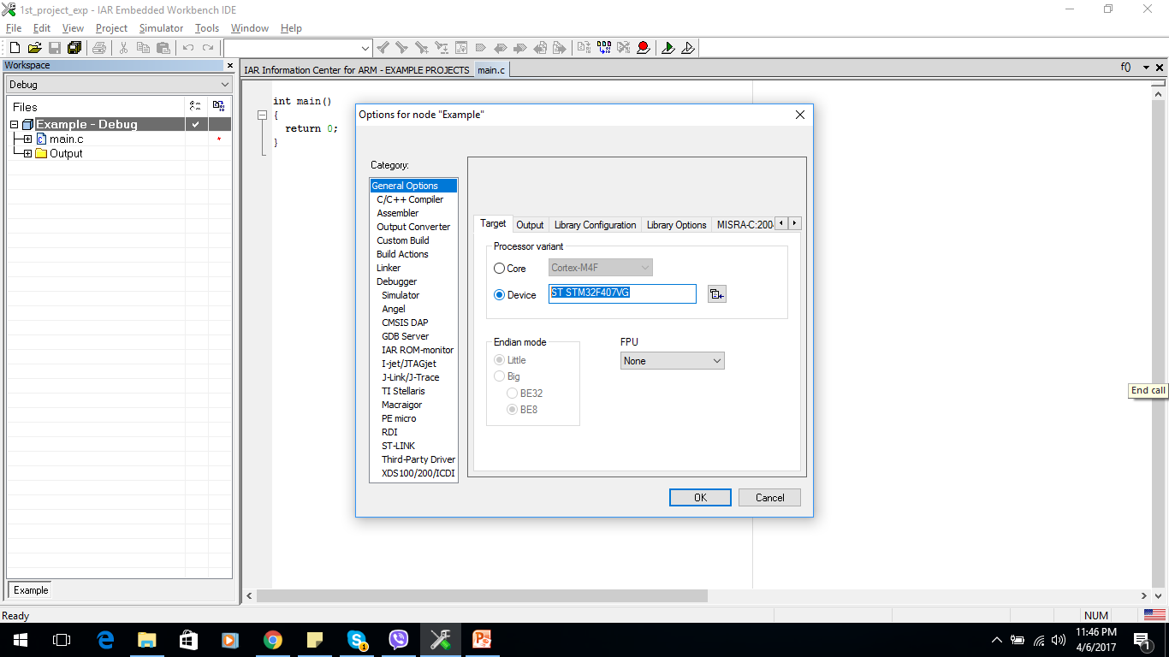
1. Create new project
Step 4: Configuration
-Choose device and FPU(none)

Slide 7
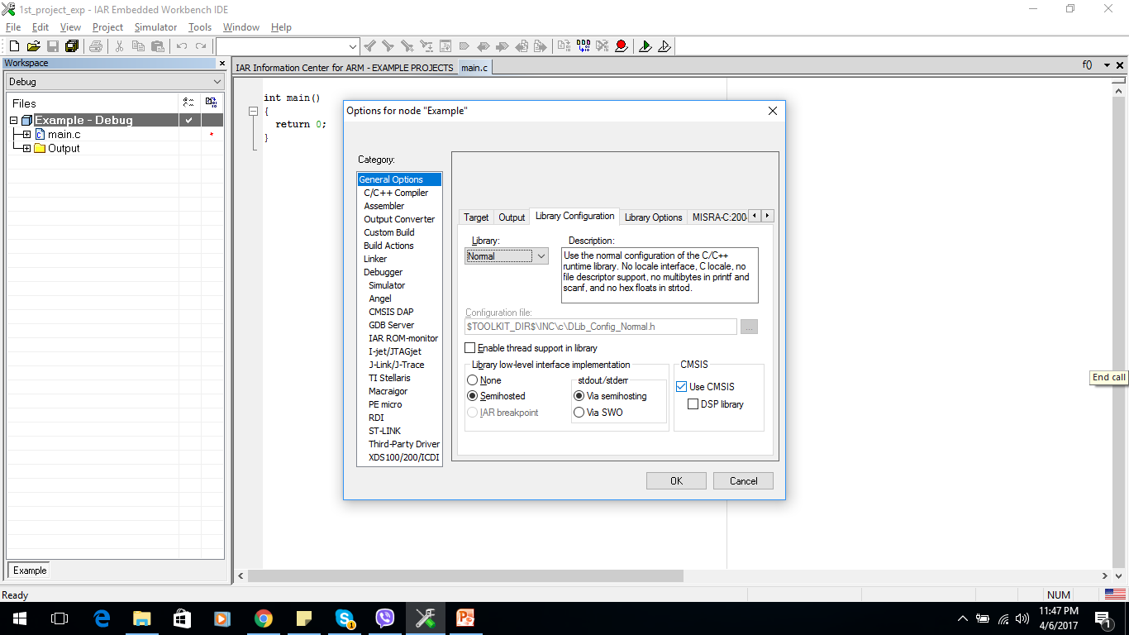
1. Create new project
Step 4: Configuration
-Choose use CMIS

Slide 8
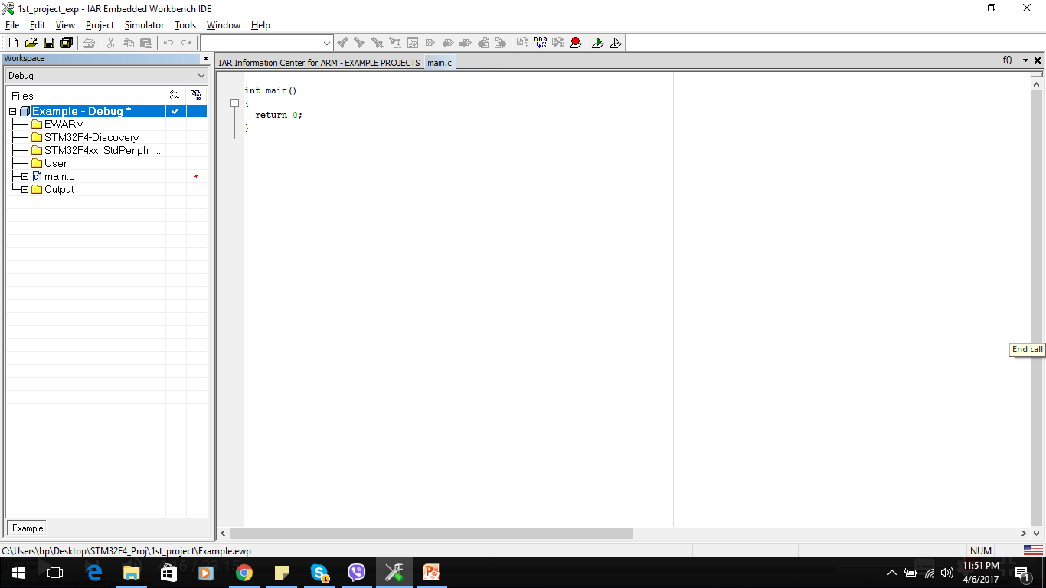
1. Create new project
Step 5: Add 3 group
EWARM: workspace of arm
STM32F4_Discovery: content discovery board driver
STM32F4xx_StdPeriph_Driver:
User: source code developer

Slide 9
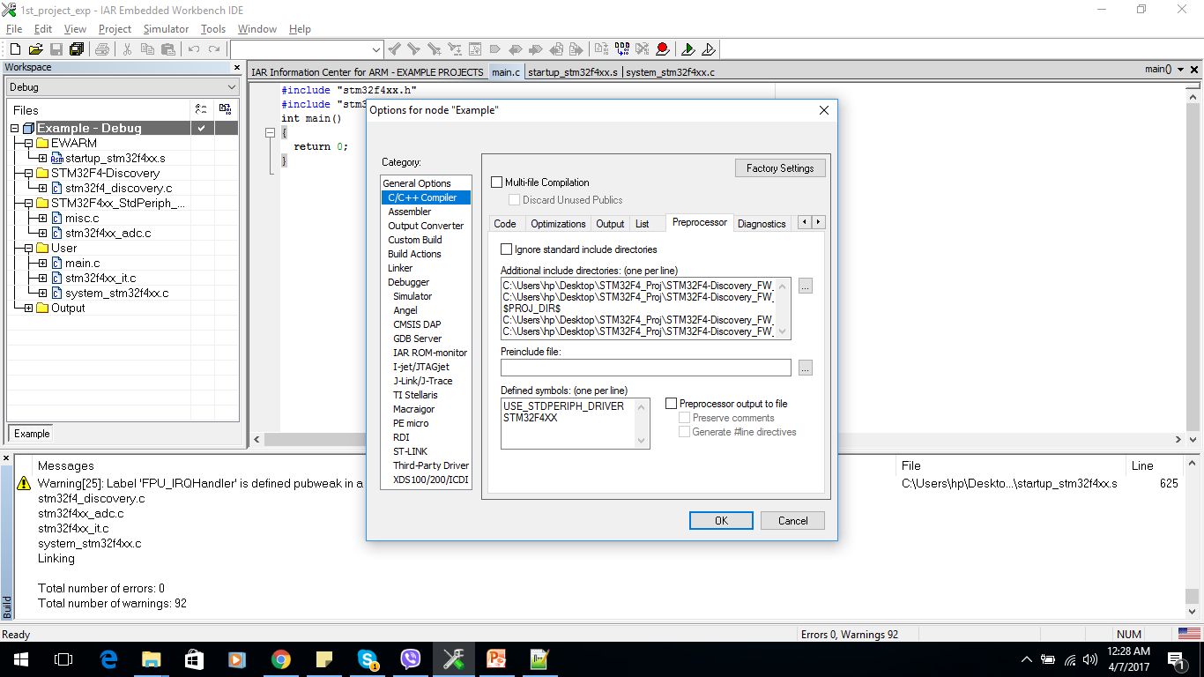
1. Create new project
Step 6: Add file for folder and compiler

Slide 10
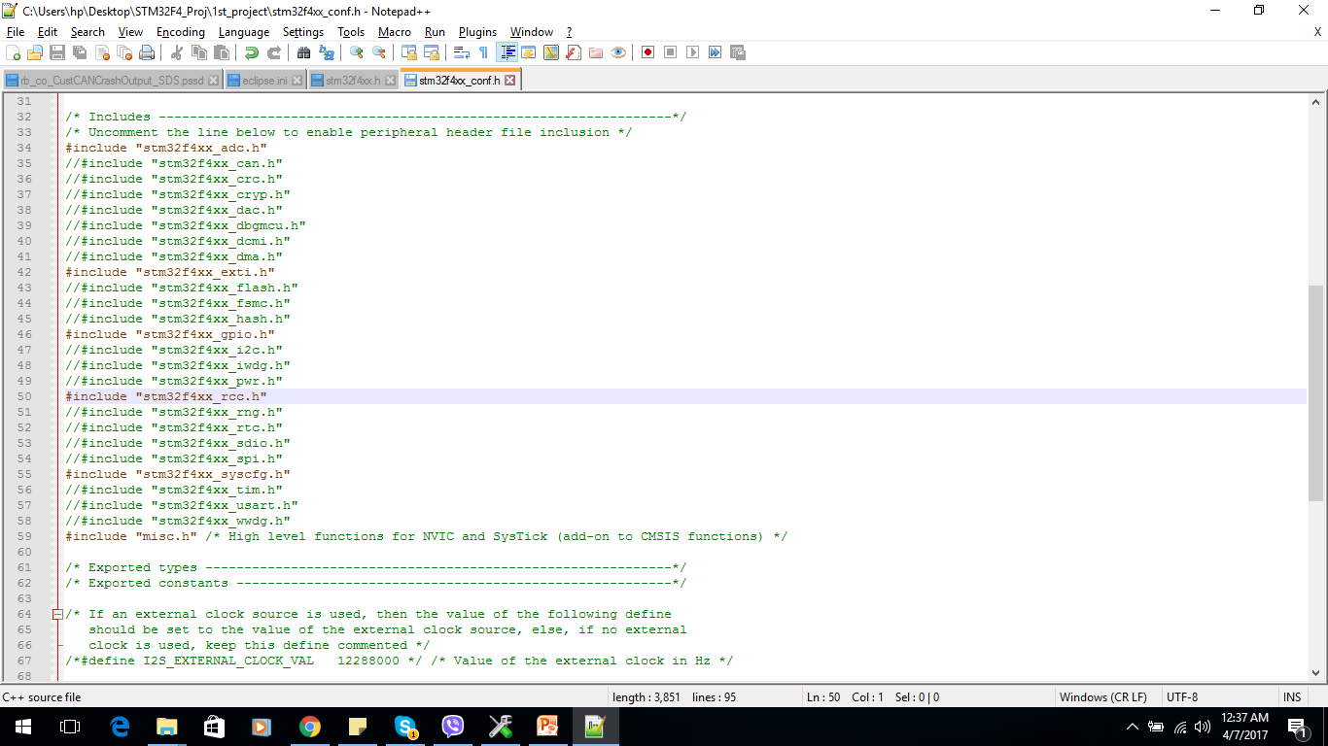
1. Create new project
Step 6:
Modified stm32f4xx_conf.h to choose which driver be used

Slide 11
1. Create new project
Step 7:
Include header in main.c
#include "stm32f4xx.h"
#include "stm32f4_discovery.h"

Slide 12
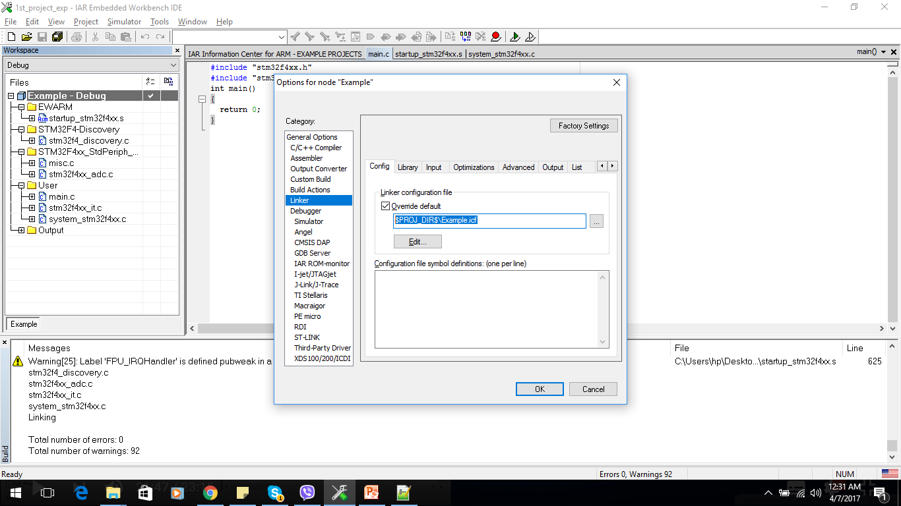
2. Linker and debugger
2.1 linker
Click linker config -> select override default
Choose the

Slide 13
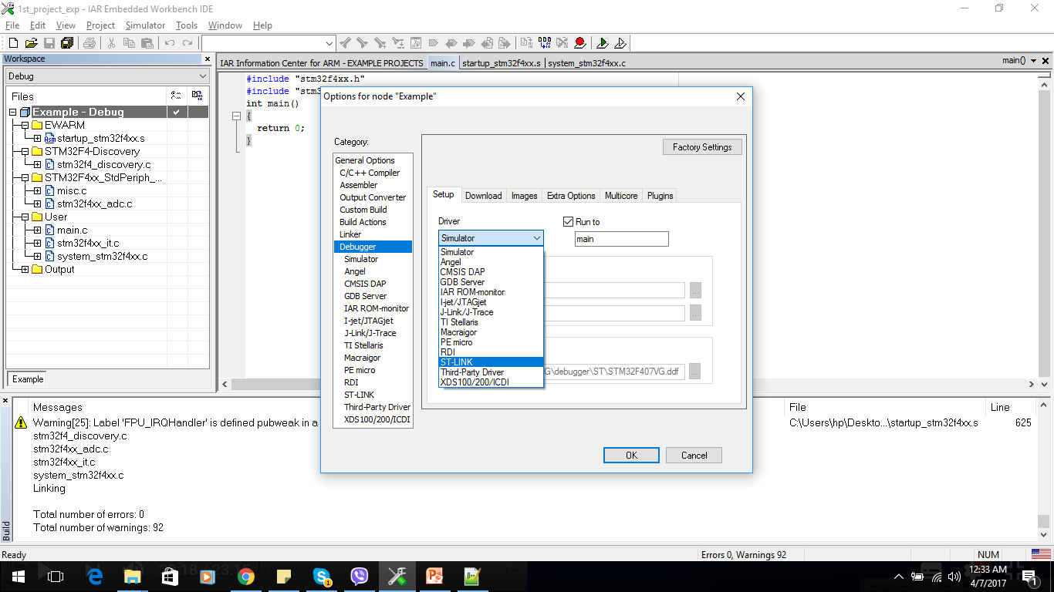
2. Linker and debugger
2.2 debug

Slide 14
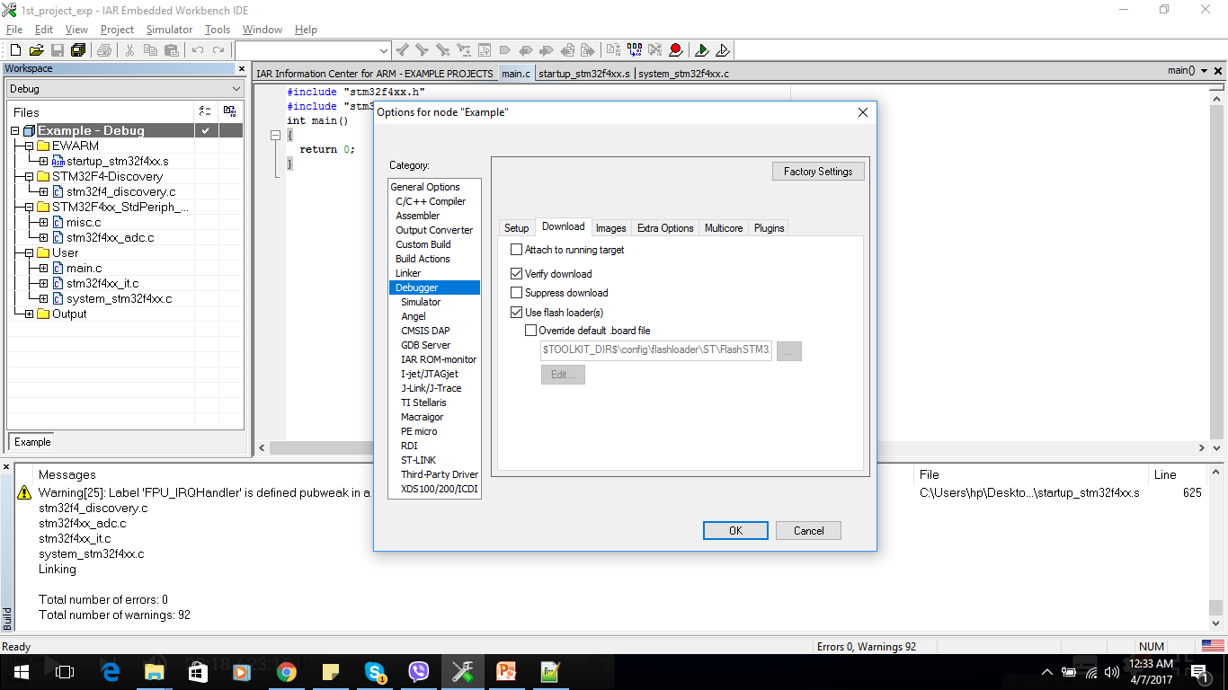
2. Linker and debugger
2.2 debug

Slide 15
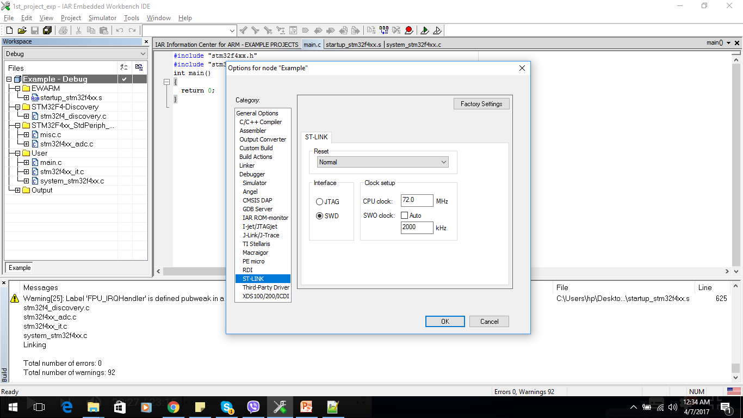
2. Linker and debugger
2.2 debug

